Slide 1
Lesson objective
Need whiteboards!
Title: Rounding and place value
Aim:
Identify place value either side of the decimal
Be able to round numbers
Plan:
Integer revision
place value
Rounding rules

Slide 2
Daily review
(HINT: if we look at last lessons notes, daily review is usually easy)
Write the statements, questions and answers into your exercise book.
Adding a negative is the same as S__________
Subtracting a negative is the same as A______
4 – (-5) =
7 + (-3) =
(-4) + (-5) =

Slide 3
Whiteboards
5 - -5 =
12 - -3 =
18 + -5 =
22 + - 10 =
-12 – 8 =
-13 - - 20 =

Slide 4
Puzzle practice
Start on + SUM UP+

Slide 5
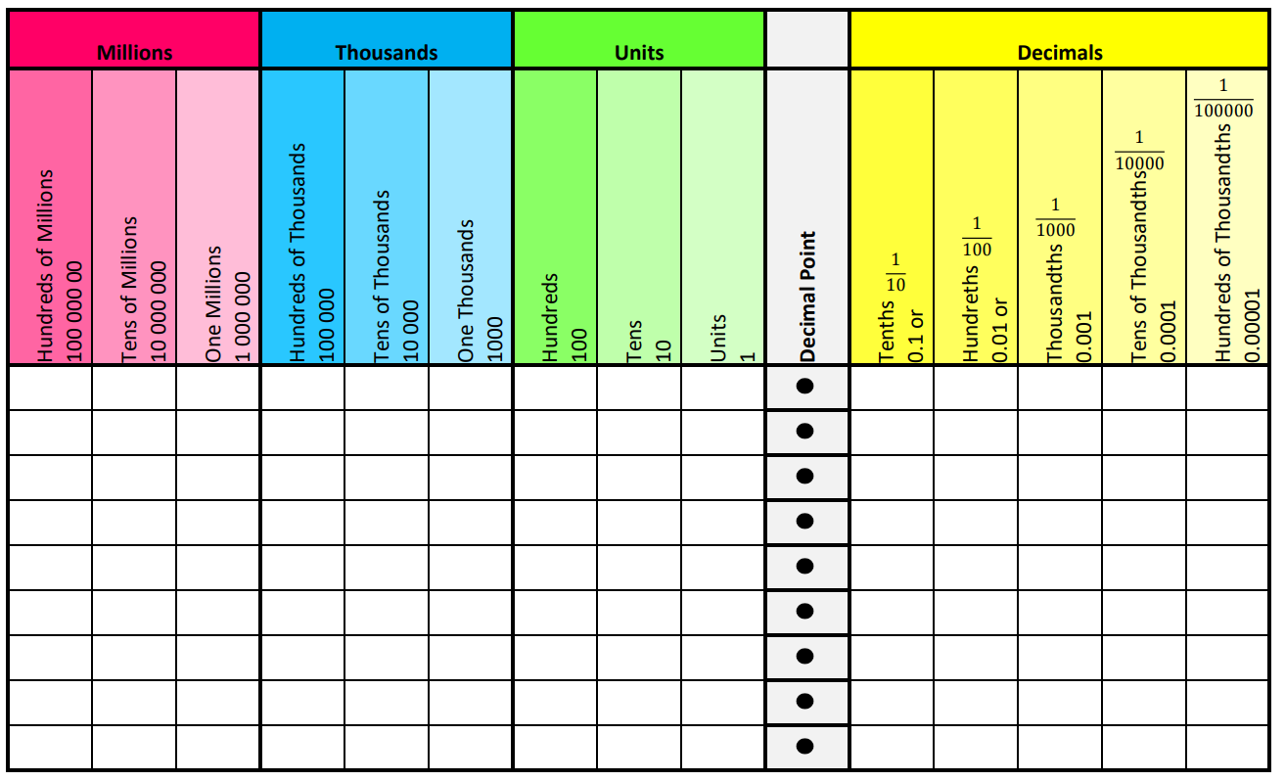
Place value
Put this sheet into your whiteboard
We will be using this today.

Slide 6
Write these numbers into your sheet
134.5
12 456.43
103 322.009
12 978 201.034
900 000.0009

Slide 7
Rounding Whole Numbers
Chop it, check it, change it
    Chop the number after the place value you want
    Check the next digit
    Change if it’s 5 or more and make the rest zero
Rounding to nearest 1
Th H T U
Th H T U
Th H T U
4 8 3 2 . 4
7 2 4 2 . 5
3 4 7 9 . 6
5 or bigger ?
5 or bigger ?
5 or bigger ?
No
Yes
Yes
4832
7243
3480

Slide 8
Rounding Whole Numbers
Chop it, check it, change it
    Chop the number after the place value you want
    Check the next digit
    Change if it’s 5 or more and make the rest zero
Rounding to nearest 10
Th H T U
Th H T U
Th H T U
4 8 3 2 4
7 2 4 2 5
3 4 7 9 6
5 or bigger ?
5 or bigger ?
5 or bigger ?
No
Yes
Yes
48320
72430
34800

Slide 9
Rounding Decimals
Chop it, check it, change it
    Chop the number after the d.p. you want
    Check the next digit
    Change if it’s 5 or more
Rounding to 1 d.p
4 . 8 3 2 5
4. 8 4 2 5
4. 8 5 2 5
5 or bigger ?
5 or bigger ?
5 or bigger ?
No
No
Yes
4.8
4.8
4.9

Slide 10
Rounding Decimals
Chop it, check it, change it
    Chop the number after the d.p. you want
    Check the next digit
    Change if it’s 5 or more
Rounding to 2 d.p
5. 8 4 2 5
1. 4 2 6 1
0. 6 0 8 3
5 or bigger ?
5 or bigger ?
5 or bigger ?
No
Yes
Yes
5.84
1.43
0.61

Slide 11
Rounding Decimals
Chop it, check it, change it
    Chop the number after the d.p. you want
    Check the next digit
    Change if it’s 5 or more
Rounding to 2 d.p
0. 2 9 4 3
0. 5 5 5 0
0. 3 9 7 0
5 or bigger ?
5 or bigger ?
5 or bigger ?
No
Yes
Yes
0.29
0.56
0.40

Slide 12
Whiteboards
Round these numbers:
Start by writing the number into our place value sheet (whiteboards)
12 to the nearest 10
145 to the nearest 100
1914 to the nearest 1000
9.12 to the nearest one (unit)
10.234 to the nearest TENTHS
12. 5431 to the nearest HUNDREDTHS

Slide 13
Skills practice
Astounding rounding Task

Slide 14
Fist to five reflection
Aim:
Identify place value either side of the decimal
Be able to round numbers

